Slide 1
UNIT - 5
JAVASCRIPT AND HTML
Browser Object Model

Slide 2
Browser Object Model (BOM)
The Browser Object Model (BOM) is used to interact with the browser.
window.alert("hello javatpoint");
OR
alert("hello javatpoint");
The document object represents an html document.
It forms DOM (Document Object Model).

Slide 3
Window Object
The window object represents a window in browser. An object of window is created automatically by the browser.
Window is the object of browser, it is not the object of javascript. The javascript objects are string, array, date etc.
Methods of window object
Method | Description
alert() | displays the alert box containing message with ok button.
confirm() | displays the confirm dialog box containing message with ok and cancel button.
prompt() | displays a dialog box to get input from the user.
open() | opens the new window.
close() | closes the current window.
setTimeout() | performs action after specified time like calling function, evaluating expressions etc.

Slide 4
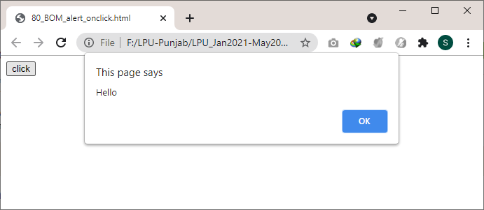
alert() : It displays alert dialog box. It has message and ok button.
Example:
<html>
<head>
<script type="text/javascript">
function msg()
{
alert("Hello ");
}
</script>
<input type="button" value="click" onclick="msg()"/>
</script>
</head>
<body>
</body>
</html>

Slide 5
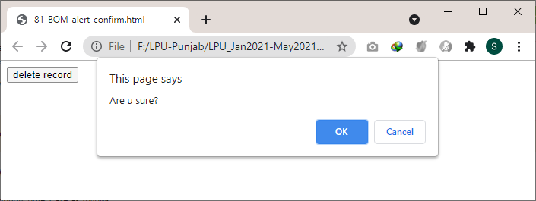
confirm(): It displays the confirm dialog box.
It has message with ok and cancel buttons.
<html>
<head>
<script type="text/javascript">
function msg(){
var v= confirm("Are u sure?");
if(v==true){
alert("ok");
}
else{
alert("cancel");
}
}
</script>
<input type="button" value="delete record" onclick="msg()"/>
</head>
<body>
</body>
</html>

Slide 6
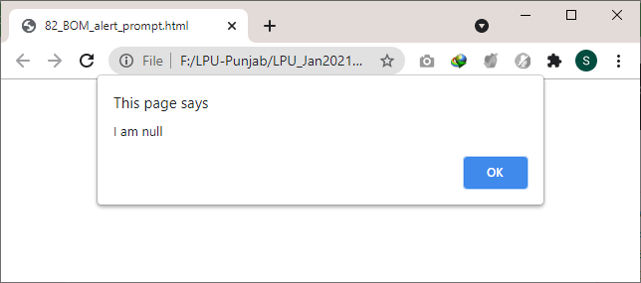
prompt():
It displays prompt dialog box for input.
It has message and textfield.
<html>
<head>
<script type="text/javascript">
function msg()
{
var v= prompt("Who are you?");
alert("I am "+v);
}
</script>
<input type="button" value="click" onclick="msg()"/>
</head>
<body>
</body>
</html>

Slide 7
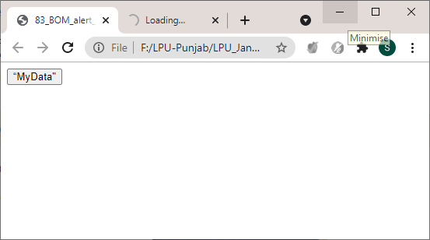
open(): It displays the content in a new window.
<html>
<head>
<script type="text/javascript">
function msg()
{
open("https://lpu.co.in");
}
</script>
<input type="button" value=“MyData" onclick="msg()"/>
</head>
<body>
</body>
</html>

Slide 8
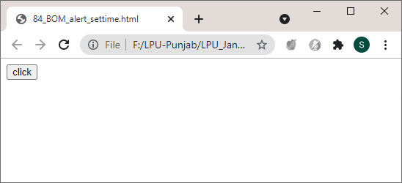
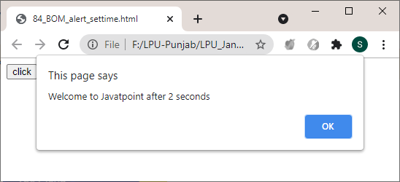
setTimeout(): It performs its task after the given milliseconds.
<html>
<head>
<script type="text/javascript">
function msg(){
setTimeout(
function()
{
alert("Welcome to Javatpoint after 2 seconds")
},2000);
}
</script>
<input type="button" value="click" onclick="msg()"/>
</head>
<body>
</body>
</html>

Slide 9
JavaScript History Object
The JavaScript history object represents an array of URLs visited by the user. By using this object, you can load previous, forward or any particular page.
The history object is the window property, so it can be accessed by:
window.history
or
history
Property of JavaScript history object
No. | Property | Description
1 | length | returns the length of the history URLs.
Methods of JavaScript history object
No. | Method | Description
1 | forward() | loads the next page.
2 | back() | loads the previous page.
3 | go() | loads the given page number.

Slide 10
Example
history.back(); //for previous page
history.forward(); //for next page
history.go(2); //for next 2nd page
history.go(-2); //for previous 2nd page

Slide 11
JavaScript Navigator Object
The JavaScript navigator object is used for browser detection. It can be used to get browser information such as appName, appCodeName, userAgent etc.
The navigator object is the window property, so it can be accessed by:
window.navigator
OR
navigator
Property of JavaScript navigator object

Slide 12
Property of JavaScript navigator object
No. | Property | Description
1 | appName | returns the name
2 | appVersion | returns the version
3 | appCodeName | returns the code name
4 | cookieEnabled | returns true if cookie is enabled otherwise false
5 | userAgent | returns the user agent
6 | language | returns the language. It is supported in Netscape and Firefox only.
7 | userLanguage | returns the user language. It is supported in IE only.
8 | plugins | returns the plugins. It is supported in Netscape and Firefox only.
9 | systemLanguage | returns the system language. It is supported in IE only.
10 | mimeTypes[] | returns the array of mime type. It is supported in Netscape and Firefox only.
11 | platform | returns the platform e.g. Win32.
12 | online | returns true if browser is online otherwise false.

Slide 13
Methods of JavaScript navigator object
No. | Method | Description
1 | javaEnabled() | checks if java is enabled.
2 | taintEnabled() | checks if taint is enabled. It is deprecated since JavaScript 1.2.
Example
<script>
document.writeln("<br/>navigator.appCodeName: "+navigator.appCodeName);
document.writeln("<br/>navigator.appName: "+navigator.appName);
document.writeln("<br/>navigator.appVersion: "+navigator.appVersion);
document.writeln("<br/>navigator.cookieEnabled: "+navigator.cookieEnabled);
document.writeln("<br/>navigator.language: "+navigator.language);
document.writeln("<br/>navigator.userAgent: "+navigator.userAgent);
document.writeln("<br/>navigator.platform: "+navigator.platform);
document.writeln("<br/>navigator.onLine: "+navigator.onLine);
</script>

Slide 14
JavaScript Screen Object
The JavaScript screen object holds information of browser screen. It can be used to display screen width, height, colorDepth, pixelDepth etc.
The navigator object is the window property, so it can be accessed by:
window.screen
OR
screen
Property of JavaScript Screen Object
No. | Property | Description
1 | width | returns the width of the screen
2 | height | returns the height of the screen
3 | availWidth | returns the available width
4 | availHeight | returns the available height
5 | colorDepth | returns the color depth
6 | pixelDepth | returns the pixel depth.

Slide 15
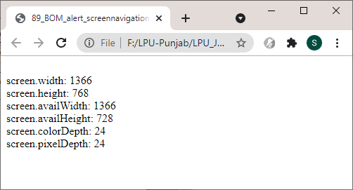
<script>
document.writeln("<br/>screen.width: "+screen.width);
document.writeln("<br/>screen.height: "+screen.height);
document.writeln("<br/>screen.availWidth: "+screen.availWidth);
document.writeln("<br/>screen.availHeight: "+screen.availHeight);
document.writeln("<br/>screen.colorDepth: "+screen.colorDepth);
document.writeln("<br/>screen.pixelDepth: "+screen.pixelDepth);
</script>

Slide 16
JavaScript DOM
Document Object Model

Slide 17
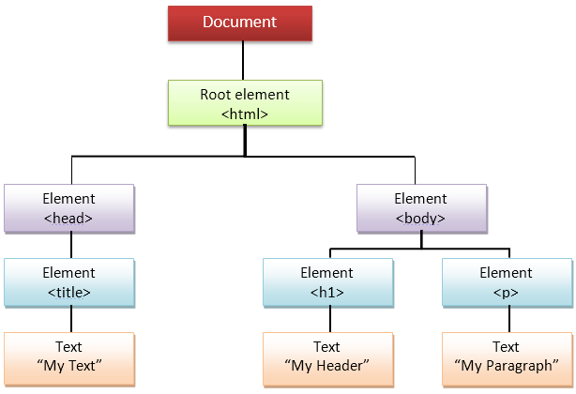
JavaScript DOM
What is DOM in JavaScript?
JavaScript can access all the elements in a webpage making use of Document Object Model (DOM). In fact, the web browser creates a DOM of the webpage when the page is loaded. The DOM model is created as a tree of objects like this:

Slide 18
The document object represents the whole html document.
When html document is loaded in the browser, it becomes a document object.
It is the root element that represents the html document. It has properties and methods.
By the help of document object, we can add dynamic content to our web page.
As mentioned earlier, it is the object of window.
window.document
OR
document
"The W3C Document Object Model (DOM) is a platform and language-neutral interface that allows programs and scripts to dynamically access and update the content, structure, and style of a document."

Slide 19
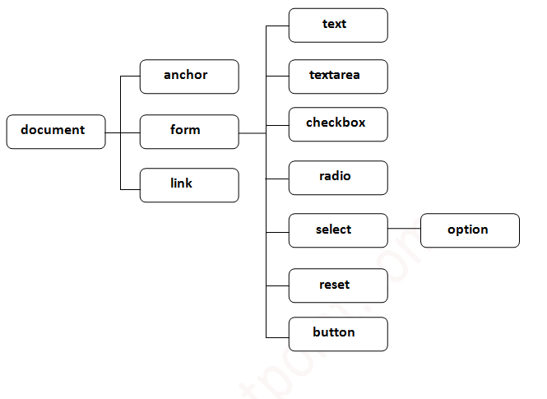
Properties of document object

Slide 20
Methods of document object
Method | Description
write("string") | writes the given string on the doucment.
writeln("string") | writes the given string on the doucment with newline character at the end.
getElementById() | returns the element having the given id value.
getElementsByName() | returns all the elements having the given name value.
getElementsByTagName() | returns all the elements having the given tag name.
getElementsByClassName() | returns all the elements having the given class name.

Slide 21
Accessing field value by document object
In this example, we are going to get the value of input text by user.
Here, we are using document.form1.name.value to get the value of name field.
Here, document is the root element that represents the html document.
form1 is the name of the form.
name is the attribute name of the input text.
value is the property, that returns the value of the input text.

Slide 22
simple example of document object that prints name with welcome message.
<script type="text/javascript">
function printvalue(){
var name=document.form1.name.value;
alert("Welcome: "+name);
}
</script>
<form name="form1">
Enter Name:<input type="text" name="name"/>
<input type="button" onclick="printvalue()" value="print name"/>
</form>

Slide 23
document.getElementById() method
The document.getElementById() method returns the element of specified id.
The document.form1.name.value is used to get the value of the input value. Instead of this, we can use document.getElementById() method to get value of the input text.
But we need to define id for the input field.

Slide 24
simple example of document.getElementById() method that prints cube of the given number.
<script type="text/javascript">
function getcube(){
var number=document.getElementById("number").value;
alert(number*number*number);
}
</script>
<form>
Enter No:<input type="text" id="number" name="number"/><br/>
<input type="button" value="cube" onclick="getcube()"/>
</form>

Slide 25
<!DOCTYPE html>
<html lang="en" dir="ltr">
<head>
<meta charset="utf-8">
<title></title>
</head>
<body>
<script type="text/javascript">
function add(){
var number=parseInt(document.getElementById("number").value);
var number2=parseInt(document.getElementById("number2").value);
alert(number+number2);
}
function sub(){
var number1=parseInt(document.getElementById("number1").value);
var number2=parseInt(document.getElementById("number2").value);
alert(number-number2);
}
function mul(){
var number1=parseInt(document.getElementById("number1").value);
var number2=parseInt(document.getElementById("number2").value);
alert(number*number2);
}
</script>
<form>
Entern No: <input typ"text" id="number1" name="number1"/><br/>
Entern No: <input typ"text" id="number2" name="number2"/><br/>
<input type="button" value="add" onclick="add()"/>
<input type="button" value="sub" onclick="sub()"/>
<input type="button" value="mul" onclick="mul()"/>
</form>
</body>
</html>

Slide 26
<html>
<head>
<title>getElementById</title>
<script>
function calculate(sign){
var number1 = parseInt(document.getElementById("number1").value);
var number2 = parseInt(document.getElementById("number2").value);
if(sign == '+')
answer = number1+number2;
else if(sign == '-')
answer = number1 - number2;
else if(sign == '*')
answer = number1*number2;
document.getElementById("answer").value = answer;
}
</script>
</head>
<body>
<form>
Enter 1st no: <input type="text" id = "number1" name = "number1"/><br/>
Enter 2nd no: <input type="text" id = "number2" name = "number2"/><br/>
<input type="button" value="+" onclick="calculate('+')"/>
<input type="button" value="-" onclick="calculate('-')"/>
<input type="button" value="*" onclick="calculate('*')"/>
<input type="text" id = "answer"/>
</form>
</body>
</html>

Slide 27
document.getElementsByName() method
The document.getElementsByName() method returns all the element of specified name.
The syntax of the getElementsByName() method is given below:
document.getElementsByName("name")

Slide 28
Example of document.getElementsByName() method
To count total number of genders. Here, we are using getElementsByName() method to get all the genders.
<script type="text/javascript">
function totalelements()
{
var allgenders=document.getElementsByName("gender");
alert("Total Genders:"+allgenders.length);
}
</script>
<form>
Male:<input type="radio" name="gender" value="male">
Female:<input type="radio" name="gender" value="female">
<input type="button" onclick="totalelements()" value="Total Genders">
</form>

Slide 29
document.getElementsByTagName() method
The document.getElementsByTagName() method returns all the element of specified tag name.
The syntax of the getElementsByTagName() method is given below:
document.getElementsByTagName("name")

Slide 30
Example of document.getElementsByTagName() method
To count total number of paragraphs used in the document.
To do this, we have called the document.getElementsByTagName("p") method that returns the total paragraphs.
<script type="text/javascript">
function countpara(){
var totalpara=document.getElementsByTagName("p");
alert("total p tags are: "+totalpara.length);
}
</script>
<p>This is a pragraph</p>
<p>Here we are going to count total number of paragraphs by getElementByTagName() method.</p>
<p>Let's see the simple example</p>
<button onclick="countpara()">count paragraph</button>

Slide 31
Example2: document.getElementsByTagName() method
To count total number of h2 and h3 tags used in the document.
<script type="text/javascript">
function counth2(){
var totalh2=document.getElementsByTagName("h2");
alert("total h2 tags are: "+totalh2.length);
}
function counth3(){
var totalh3=document.getElementsByTagName("h3");
alert("total h3 tags are: "+totalh3.length);
}
</script>
<h2>This is h2 tag</h2>
<h2>This is h2 tag</h2>
<h3>This is h3 tag</h3>
<h3>This is h3 tag</h3>
<h3>This is h3 tag</h3>
<button onclick="counth2()">count h2</button>
<button onclick="counth3()">count h3</button>
Note: Output of the given examples may differ on this page because it will count the total number of para , total number of h2 and total number of h3 tags used in this document.

Slide 32
Javascript - innerHTML
The innerHTML property can be used to write the dynamic html on the html document.
It is used mostly in the web pages to generate the dynamic html such as registration form, comment form, links etc.

Slide 33
Example of innerHTML property
To create the html form when user clicks on the button.
we are dynamically writing the html form inside the div name having the id mylocation. We are identifing this position by calling the document.getElementById() method.
<script type="text/javascript" >
function showcommentform() {
var data="Name:<input type='text' name='name'><br>Comment:<br><textarea rows='5' cols='80'></textarea>
<br><input type='submit' value='Post Comment'>";
document.getElementById('mylocation').innerHTML=data;
}
</script>
<form name="myForm">
<input type="button" value="comment" onclick="showcommentform()">
<div id="mylocation"></div>
</form>

Slide 34
Show/Hide Comment Form Example using innerHTML
<!DOCTYPE html>
<html>
<head>
<title>First JS</title>
<script>
var flag=true;
function commentform(){
var cform="<form action='Comment'>Enter Name:<br><input type='text' name='name'/><br/>
Enter Email:<br><input type='email' name='email'/><br>Enter Comment:<br/>
<textarea rows='5' cols='70'></textarea><br><input type='submit' value='Post Comment'/></form>";
if(flag){
document.getElementById("mylocation").innerHTML=cform;
flag=false;
}else{
document.getElementById("mylocation").innerHTML="";
flag=true;
}
}
</script>
</head>
<body>
<button onclick="commentform()">Comment</button>
<div id="mylocation"></div>
</body>
</html>

Slide 35
Javascript - innerText
The innerText property can be used to write the dynamic text on the html document. Here, text will not be interpreted as html text but a normal text.
It is used mostly in the web pages to generate the dynamic content such as writing the validation message, password strength etc.

Slide 36
Javascript innerText Example
To display the password strength when releases the key after press.
<script type="text/javascript" >
function validate() {
var msg;
if(document.myForm.userPass.value.length>5){
msg="good";
}
else{
msg="poor";
}
document.getElementById('mylocation').innerText=msg;
}
</script>
<form name="myForm">
<input type="password" value="" name="userPass" onkeyup="validate()">
Strength:<span id="mylocation

Slide 37
How to use DOM and Events
Using DOM, JavaScript can perform multiple tasks. It can create new elements and attributes, change the existing elements and attributes and even remove existing elements and attributes. JavaScript can also react to existing events and create new events in the page.
getElementById, innerHTML Example
getElementById: To access elements and attributes whose id is set.
innerHTML: To access the content of an element.

Slide 38
<html>
<head>
<title>DOM!!!</title>
</head>
<body>
<h1 id="one">Welcome</h1>
<p>This is the welcome message.</p>
<h2>Technology</h2>
<p>This is the technology section.</p>
<script type="text/javascript">
var text = document.getElementById("one").innerHTML;
alert("The first heading is " + text);
</script>
</body>
</html>

Slide 39
getElementsByTagName Example
getElementsByTagName: To access elements and attributes using tag name. This method will return an array of all the items with the same tag name.
<html>
<head>
<title>DOM!!!</title>
</head>
<body>
<h1>Welcome</h1>
<p>This is the welcome message.</p>
<h2>Technology</h2>
<p id="second">This is the technology section.</p>
<script type="text/javascript">
var paragraphs = document.getElementsByTagName("p");
alert("Content in the second paragraph is " + paragraphs[1].innerHTML);
document.getElementById("second").innerHTML = "The orginal message is changed.";
</script>
</body>
</html>

Slide 40
Event handler Example
createElement: To create new element
removeChild: Remove an element
You can add an event handler to a particular element like this:
document.getElementById(id).onclick=function()
{
lines of code to be executed
}
OR
document.getElementById(id).addEventListener("click", functionname)

Slide 41
<html>
<head>
<title>DOM!!!</title>
</head>
<body>
<input type="button" id="btnClick" value="Click Me!!" />
<script type="text/javascript">
document.getElementById("btnClick").addEventListener("click", clicked);
function clicked()
{
alert("You clicked me!!!");
}
</script>
</body>
</html>

Slide 42
<html>
<head>
<title>Objects!!!</title>
<script type="text/javascript">
var student = new Object();
student.fName = "John";
student.lName = "Smith";
student.id = 5;
student.markE = 76;
student.markM = 99;
student.markS = 87;
student.calculateAverage = function()
{
return (student.markE + student.markM + student.markS)/3;
};
student.displayDetails = function()
{
document.write("Student Id: " + student.id + "<br />");
document.write("Name: " + student.fName + " " + student.lName + "<br />");
var avg = student.calculateAverage();
document.write("Average Marks: " + avg);
};
student.displayDetails();
</script>
</head>
<body>
</body>
</html>

Slide 43
<html>
<head>
<script type="text/javascript">
function Student(first, last, id, english, maths, science)
{
this.fName = first;
this.lName = last;
this.id = id;
this.markE = english;
this.markM = maths;
this.markS = science;
this.calculateAverage = function()
{
return (this.markE + this.markM + this.markS)/3;
}
this.displayDetails = function()
{
document.write("Student Id: " + this.id + "<br />");
document.write("Name: " + this.fName + " " + this.lName + "<br />");
var avg = this.calculateAverage();
document.write("Average Marks: " + avg + "<br /><br />");
}
}
var st1 = new Student("John", "Smith", 15, 85, 79, 90);
var st2 = new Student("Hannah", "Turner", 23, 75, 80, 82);
var st3 = new Student("Kevin", "White", 4, 93, 89, 90);
var st4 = new Student("Rose", "Taylor", 11, 55, 63, 45);
st1.displayDetails();
st2.displayDetails();
st3.displayDetails();
st4.displayDetails();
</script>
</head>
<body>
</body>
</html>

Slide 44
<html>
<head>
<script type="text/javascript">
var employee={first:"John", last:"Doe", department:"Accounts"};
var details = "";
document.write("<b>Using for/in loops </b><br />");
for (var x in employee)
{
details = x + ": " + employee[x];
document.write(details + "<br />");
}
</script>
</head>
<body>
</body>
</html>

